Slide 1
Token Economies
COMP6212 Computational Finance

Slide 2
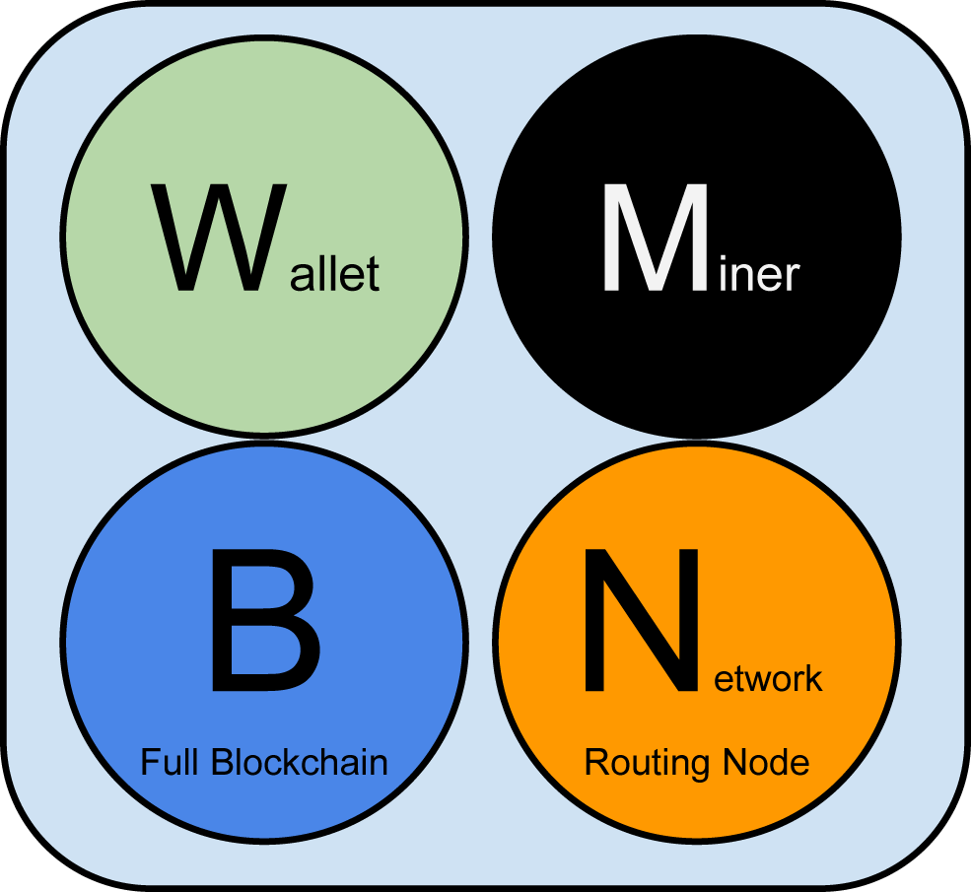
Recap on bitcoin advantages
Decentralised peer to peer network of distributed ledgers
Each node has a copy of the blockchain (full or partial (lightweight-SPV))
Full-node bottom up validation, from genius node to current node (160GB)
SPV- top down, headers only, 6 blocks on top to be valid
Wallets are lightweight nodes
Blockchain assures that the state of a ledger is persistent and trustworthy at all times.
Does not require a third party authority to tell what in a ledger is true or false.
No central point of failure, so fault tolerance
Nodes –verify transaction data, send and receive transaction data
Difficult to attack- cost much more resourced to attack a decentialised system.
Collusion Resistant, much harder for participants collude and act in ways that benefit them at the expense of other participants,
Notes:
whereas the leadership of corporations and governments collude in ways that benefit themselves but harmless well-coordinated citizens, customers, employees and the general public all the time.

Slide 3
Recap on bitcoin advantages
Consensus algorithms -Mining nodes
Verify transactions: ensures the rules are followed
Build the block of transaction and distribute
Timestamped
Chained together
Proof of work

Slide 4
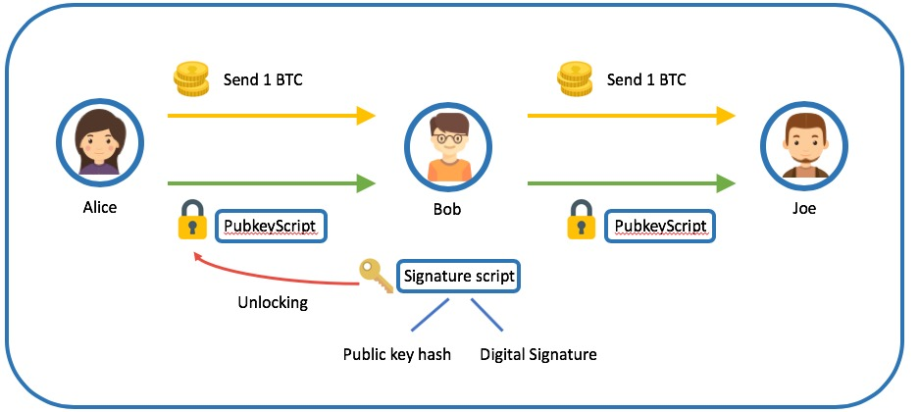
Recap on bitcoin advantages
Code
Bitcoin protocol; on top of the internet
Bitcoin core (open source)
Wallets storing private keys (can be cold storage hardware or paper)
Explorer: tracks transactions, addresses and activity.
SCRIPT
Automates exudations of commands
Limited functionality, works on simple devices
Locks (publickey) unlocks (privatekey)
Can be timebound
Conditional Clauses If, Then, Else
Cryptographic security
Notes:
Back up wallets

Slide 5
Bitcoin as an alternative platform
The bitcoin open source platform gives us a
programmable, transparent, immutable, integrity, accountable , auditable de-centralized, consensus, timestamping and secure peer to peer interactive platform
Can be used to record legal ownership of assets
Hence external assists can be traded on the bock chain
Example shipping goods from China to EU
Ensure the vendor gets paid, Merchant wants good to arrive safely first
Takes a month to sail across the ocean, so money held in escrow accounts
middlemen become gatekeepers at strategic points in the value chain controlling trade channels - in economics as rent seeking.
Replaced by a smart contract.
Notes:
Digital notary and asset registers the block chain properties of Bitcoin and make it a perfect system for demonstrating proof of ownership block chain.
It can be used to register the ownership and transfers of any kind of asset or property rights including intangible property like trademarks and intellectual property such implementations can be realized through separate dedicated block chains.
In this way assets external to the block chain can be digitalized and traded on it.

Slide 6
Meta Coins
We can extend the Bitcoin protocol
use either a new blockchain or ties into Bitcoin’s blockchain whilst adding more features.
The idea of MetaCoins is to add additional functionality to the Bitcoin protocol
MetaCoins that use the Bitcoin blockchain benefit from the high level of security in the system due to its high network hashing power with the downside that they have to use space and memory in Bitcoin’s blockchain.
The Bitcoin team came up with a compromise
allow developers to use the security of the blockchain as well as reducing the burden on the network and bloating of the blockchain.
They did this by adding the OP_RETURN function which allows a 40 byte field where data can be stored as a transaction in the blockchain but not effecting the balance.
As such a Bitcoin can be given colour

Slide 7
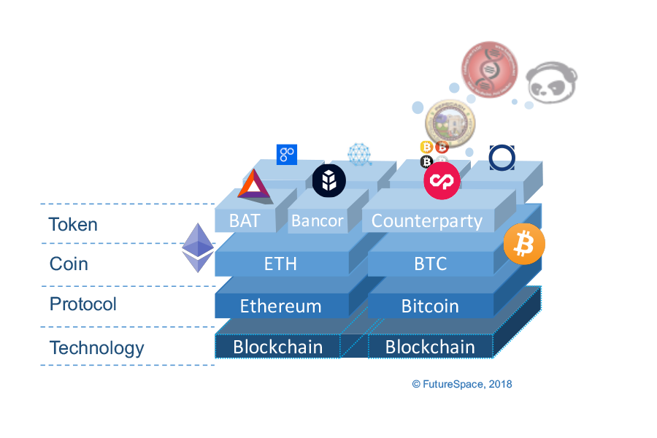

Slide 8
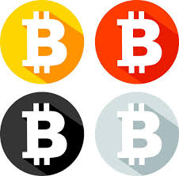
Coloured Coins
Not literal but a concept.
Embedding a piece of metadata that identifying these as belonging to a particular group – when coloured coins are created the relevant piece of code is inserted in a bitcoin transaction
can serve as a certificate of ownership of any kind of asset commodity or property on the Bitcoin block chain and creates an asset ID with time stamp.
When transacted on the Bitcoin block chain this effectively transfers the value and ownership of the external assets associated with the coloured coins.
An extremely small amount of nominal bitcoin value- A satoshi one hundred millionth of a single bitcoin (0.00000001 BTC)

Slide 9
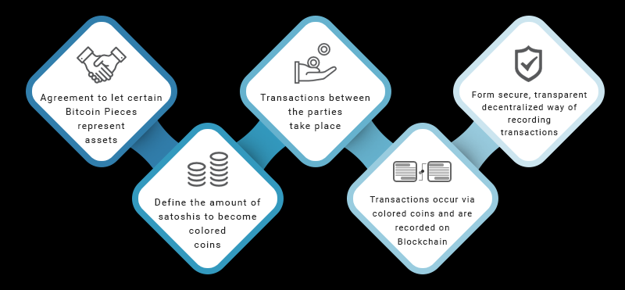

Slide 10
Example
You run a restaurant, and every time a person pays for a meal the get a coloured coin, 10 coloured coins equals a free meal.
You have a store of gold, you can give colour coins that are redeemable for a certain amount of gold
this can be implemented for any type of asset from titles to stocks to IOU.
Does require it own special wallet to hold and manage the coloured coins.
Notes:
https://www.youtube.com/watch?v=889JSfIaPzs

Slide 11
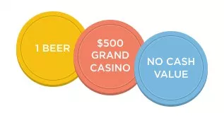
Tokens
These distributed ledgers can account for and validate the exchange of any form of value;
currency, it may be property, a kilowatt-hour of energy, the usage of a parking spot
A token is simply a quantified unit of value.
Generic - define any form of value
Fungible -it is exchangeable between different specific forms of value.

Slide 12
Tokens
Are digital and programmable,
enables us to specify rules for exchange of that that token and enabling constraints in its usage.
We can give conditions that are not only technical, we can stop blood diamonds being spend - expressing social values.
Automating these controls leads to a considerable decrease in bureaucracy.
Asset-backed tokens are the digital equivalent.
The claim is based on the underlying asset (gold), the specific issuer has (the goldsmith).
The transactions as tokens get passed between people are recorded on the blockchain,
to claim the underlying asset, you redeem the token to the issuer, and the issuer gives you the underlying asset.

Slide 13
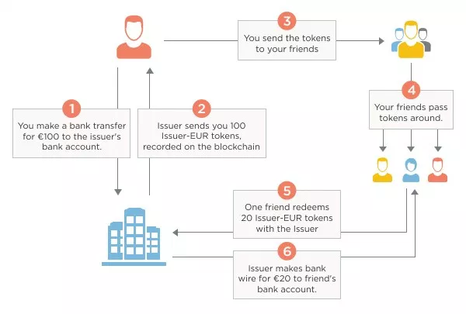

Slide 14
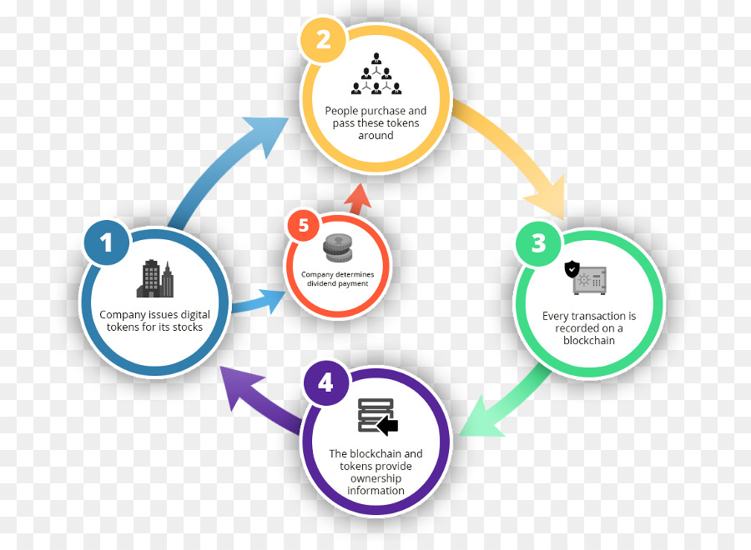

Slide 15
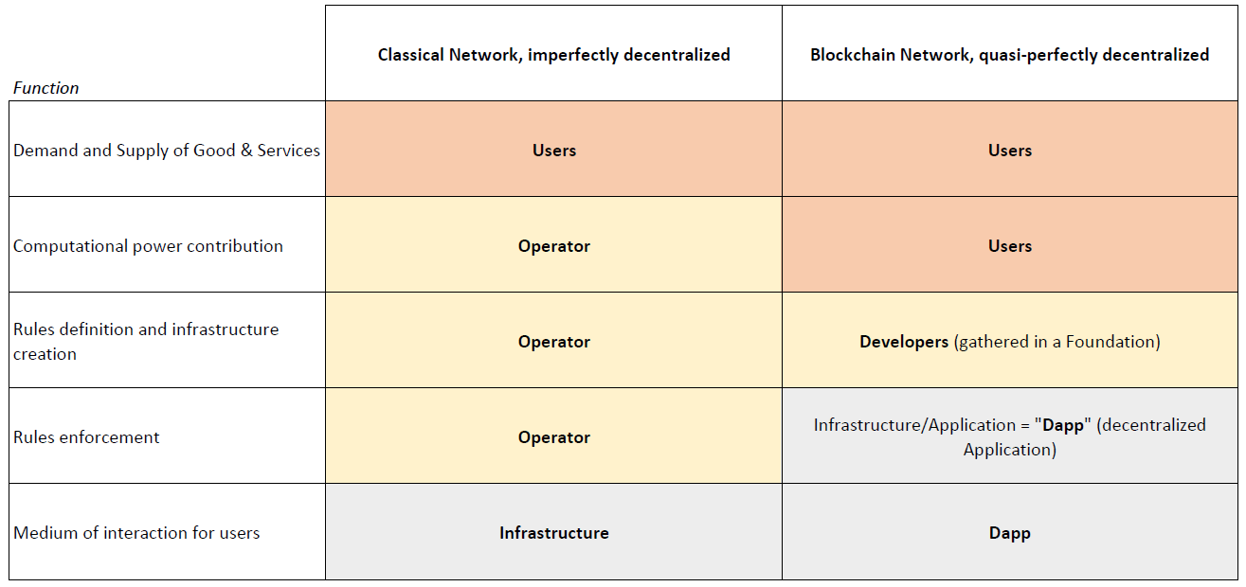
Tokens - Economies
Been around since the 1990, but now on the blockchain
Decentralized Applications are called “Dapps”
Notes:
https://blog.otiumcapital.com/token-economy-101-or-why-blockchain-powered-decentralized-networks-are-important-310de1cc8bac
Blockchains and Open Source undermine the role of the Operator:
Rules enforcement control and computing power contribution: Helped by Users who provide it with computing power, the Infrastructure is able to enforce its own rules (the application code, which obeys only to itself, makes law and applies it), and therefore does not need an Operator for it. The Infrastructure then becomes an “Infrastructure+Application”, a Decentralized Application (called “Dapp”)
Building the Infrastructure and defining Rules: All that remains is the role of rules definition and creation of the Dapp, which is supported by the application’s developers. The community of Developers (often gathered within one foundation) is thus all that remains of the Operator

Slide 16
Token -legal
There is a difference between tracking an exchange on a ledger and actually legally dematerialising the object.
For example paper share certificates have now mostly been replaced by ownership registers in databases. Some paper contracts have been replaced with pdf files.
you own the share because your name is on the share registry, the real legal share registry.
So while you can declare “this digital token represents a share of a company”, and you can send that to someone else, this has no legal bearing. The token isn’t the share, even if you own the share in real life, and you issue the token on the back of it. The token is something outside the law which you have invented.
You can give them certain privileges, for example if you own this token, I will pass any dividends I get (from really owning the share) to you.
The official register of shares is not yet on the blockchain- so be aware

Slide 17
Digital Tokens
Tokens become the local currencies of decentralized applications
They can be obtained in three ways:
User on the Dapp, offering their services in exchange for Tokens
By participating in Initial Coin Offering “ICOs”, 80% are sold, 20% stays for the developers and founders
By purchasing on the secondary market
Tokens are genuine, programmable assets, whose functioning is encoded in the Dapp’s mechanics.

Slide 18
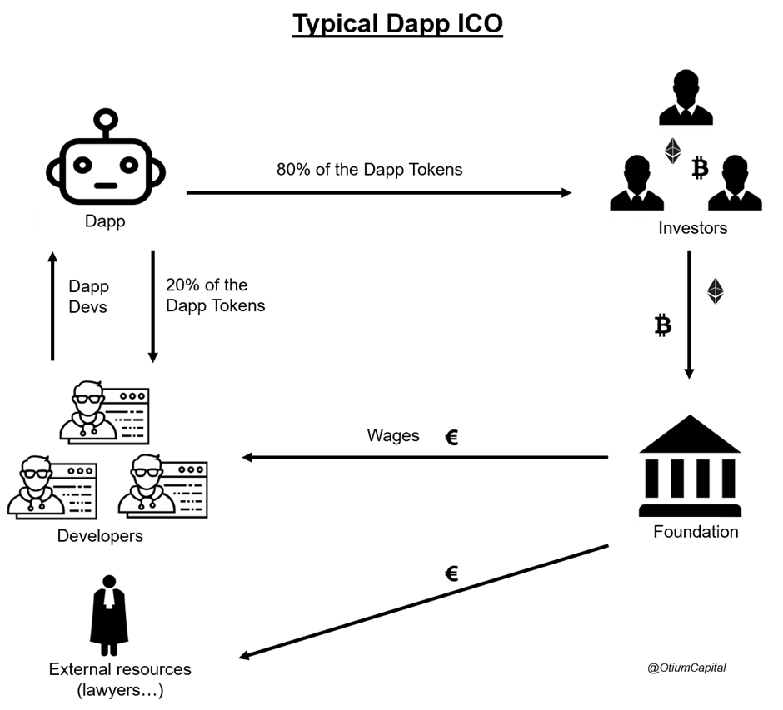
Dapp ICO

Slide 19
Examples
Storj is a decentralized DropBox, Token is called the “Storjcoin”
platform takes payment, sends files to suppliers for encrypting and storing. Suppliers are paid in Storjcoin.
Golem is a decentralized form of Amazon Web Services, Token is “Golem”
System send calculation to supplier and are paid in Golem on completion of the calculation.
Augur is a decentralized Bookmaker, make mutual bets, Token is “REP”
Bets are placed, the community votes on the outcome, the majority wins.
Correct bets get a reward, the cheater (betting against the majority) get tokens confiscated.

Slide 20
Token
A Decentralized Autonomous Organization (DAO)
Not a legal entity or formal contracts
A group of people bound together by cryptographic tokens (incentives) and fully transparent rules that are written into the software.
Usage tokens: A token that is required to use a service
Token ownership does not give you any specialized rights within the network, but it does give you access to the service
Scarce tokens combined with a useful service can create value for token holders and entrepreneurs.
Work tokens: A token that gives users the right to contribute work to a DAO and earn in exchange for their work
Not mutually exclusive
For example the ETH when Ethereum transitions from proof of work to proof of stake.

Slide 21
Token
Intrinsic, Native or Built-in Tokens
block validation incentives (‘miner rewards and transaction spam prevention).
The logic behind this is that if all transactions are paid, it limits the ability to spam.
Application Tokens
Ethereum tokens issued on the application layer through smart contracts -dApp tokens or complex DAO tokens.
Asset-backed tokens
that are issued by a party onto a blockchain for later redemption.
They are the digital equivalent to physical assets.

Slide 22
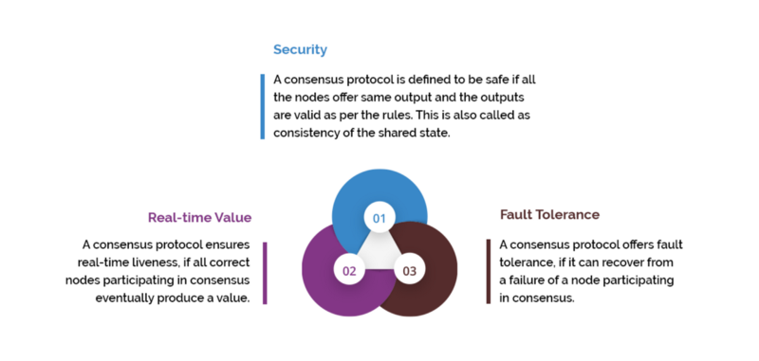
Consensus Rules

Slide 23
Consensus Rules overview
All participants have to reach consensus over the order of all transactions that have taken place,
irrespectively of whether a participant has taken part in a particular transaction or not.
All participants have to agree upon a common ledger and all participants have access to all entries ever recorded.
Concerning the data stored on the ledger, even though records are anonymized, they are nevertheless accessible to all participants, which is problematic for applications that require a higher degree of privacy.

Slide 24
Consensus Rules overview
As the blockchain network might involve mutually distrusting and anonymous parties, a consensus mechanism has to be employed that protects the ledger against fraudulent or adverse participants that attempt double-spends.
For example a consensus mechanism could be established by mining based on the proof-of-work (PoW).

Slide 25
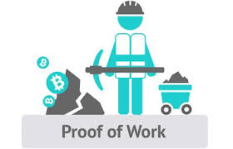
Consensus Rules overview
Proof of Work: You participate you need to solve a crypto puzzle by spending money on dedicated equipment and use a lot electricity
You get a reward if you solve the puzzle.
It does not pay to cheat
The majority of Altcoins are software forks of the Bitcoin protocol and minor changes to the proof of work (PoW) algorithm.
Notes:
https://en.bitcoin.it/wiki/Proof_of_work
https://en.bitcoin.it/wiki/Proof_of_Stake
Proof of Stake sounds like a good idea, but ironically, there is the “Nothing at Stake” problem. Since mining Bitcoins is costly, it is not smart to waste your energy on a fork that won’t earn you any money, however with Proof of Stake, it is free to mine a fork.

Slide 26
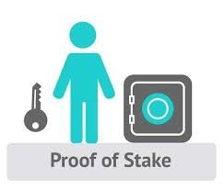
Consensus Rules overview
Proof of Stake (PoS): the miner has to give prove they own a certain amount of currency, their ‘stake‘ to take part.
the resource that’s compared is the amount of Bitcoin a miner holds – someone holding 1% of the Bitcoin can mine 1% of the “Proof of Stake blocks”.
The higher stake you have, the more likely you are to generate a block.
Prevent users from creating forks because it will devalue their stake.
Notes:
https://en.bitcoin.it/wiki/Proof_of_work
https://en.bitcoin.it/wiki/Proof_of_Stake
Proof of Stake sounds like a good idea, but ironically, there is the “Nothing at Stake” problem. Since mining Bitcoins is costly, it is not smart to waste your energy on a fork that won’t earn you any money, however with Proof of Stake, it is free to mine a fork.

Slide 27
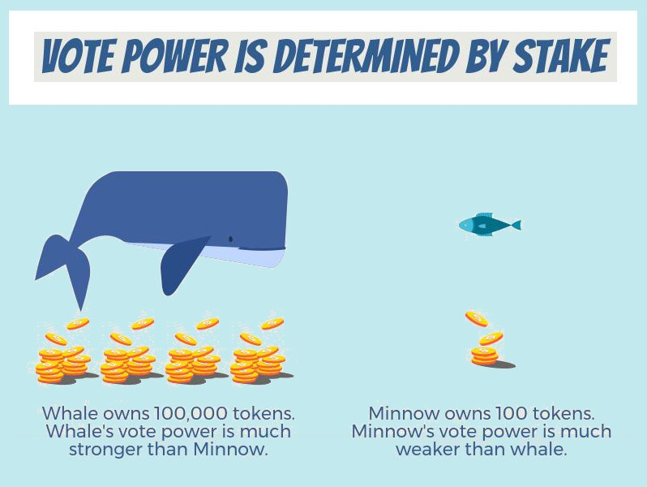
Consensus Rules overview
Delegated Proof of Stake uses a reputation system and real-time voting to achieve consensus
a panel of trusted parties has to be established, with all of its members eligible to create blocks and prevent non-trusted parties from participating.
They are unable to change transaction details.
Anyone who behaves in a nefarious way will have their behaviour exposed to the public.
Community members of the DPoS-capable currencies can vote to have said person removed as a delegate altogether.
Notes:
https://themerkle.com/what-is-delegated-proof-of-stake/

Slide 28

Consensus Rules overview
Proof of burn, miners shows that they have burned some coins, this sent them to a verifiable unspendable address
Cost the miner to do this but does not does not consume recourses
Proof of Authority (PoA) used in a private blockchain which essentially gives one client (or a specific number of clients) with one particular private key the right to make all of the blocks in the blockchain.
Notes:
https://en.bitcoin.it/wiki/Proof_of_burn
https://medium.com/poa-network/proof-of-authority-consensus-model-with-identity-at-stake-d5bd15463256

Slide 29
Consensus Rules overview
Byzantine Fault Tolerance (BFT) is known to work fast.
Practical Byzantine Fault Tolerance (PBFT) used in Hyperledger (pluggable). It’s fast but it can only be used in private, permissioned networks
Federated Byzantine Agreement (FBA). This one is used by Stellar and Ripple.
Notes:
https://themerkle.com/what-is-delegated-proof-of-stake/

Slide 30
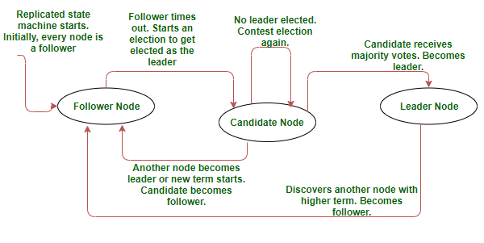
Consensus Rules overview
Raft an algorithm is based on choosing a leader who is followed by followers. The leader determines validity. Raft is a very fast.

Slide 31
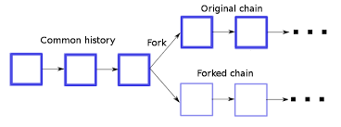
Consensus Rules – Upgrading or changing
Blockchain protocols open sourced auto-enforce predefined consensus rules in distributed networks without centralized management
over time, there is a need to upgrade – forks (hard or soft)
Requires need majority consensus by all stakeholders in the network.
Forks: an open-source code modification.
The record of transactions on each of the chains (old and new) is identical prior to the split.
Notes:
While the protocol can be upgraded through a hard fork or a soft fork and these forks can be highly controversial
Modifications with reference implementations get tested on the testnet.
After successful testing developers implement the changes into the Bitcoin software.
Who has a say in the consensus process? (1) Software Developers (do the reference implementations); (2) Miners (Runtime consensus for mining blocks); (3) Exchanges (They run nodes that validate transactions); (4) Wallet companies (create transactions run on nodes); (5) Merchants (Merchant processing also through nodes).
a fork can happen accidentally when not all nodes are replicating the same information. Usually these forks are identified and resolved,

Slide 32
Consensus Rules – Soft Fork
an still work with older versions, as not all nodes need updating.
Eg. A modification to the rules but not effecting the structure, say change the limit of a block size
A old-miner might realise that a block has been reject so will upgrade.
Merchants can read both the old and new nodes. Since all blocks with the new softforked in rules also follow the old rules.
Requires a hardfolk to change back, as the new nodes are proper subset of what was valid pre-fork.
For this to work only a majority of the mining power needs to be running a client recognizing the fork.
The more miners that accept the new rules, the more secure the network is post-fork.

Slide 33
Consensus Rules – Hard Fork
a radical change to the protocol that makes previously invalid blocks/transactions valid (or vice-versa).
all nodes or users to upgrade to the latest version of the protocol
invalidating transactions confirmed by nodes that have not been upgraded to the new version of the protocol software.
Similar to a database roll-back
Notes:
ollowing the hack on the DAO, the Ethereum community almost unanimously voted in favor of a hard fork in order to roll back transactions that siphoned off tens of millions of dollars worth of digital currency by an anonymous hacker. The hard fork also allowed DAO token holders to get their ether funds returned to them.
The proposal did not exactly unwind the network’s transaction history. Rather, it relocated the funds tied to The DAO to a newly created smart contract with the single purpose of letting the original owners withdraw them. DAO token holders will be able to withdraw ETH at a rate of approximately 1 ETH to 100 DAO. The extra balance and any ether that remains as a result of the re-entrancy exploit and the splitting mechanism will be withdrawn and distributed by the DAO curators, or individuals selected prior to the collapse of the DAO to provide "failsafe protection" for the organization.

Slide 34
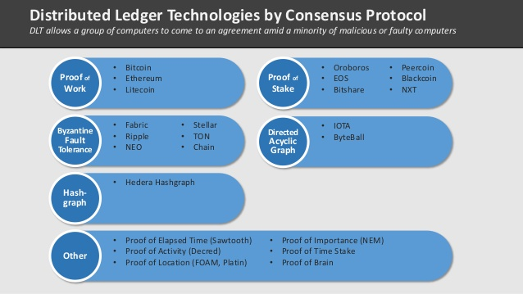

Slide 35
Platforms

Slide 36
Different platforms- overview
Three main platforms other than bitcoin
Ethereum generic platform for all kinds of transactions and applications
Hyperledger Fabric developed with a modular and extendable architecture for various industries
R3 Corda developed for the financial services industry
Ripple a digital currency

Slide 37
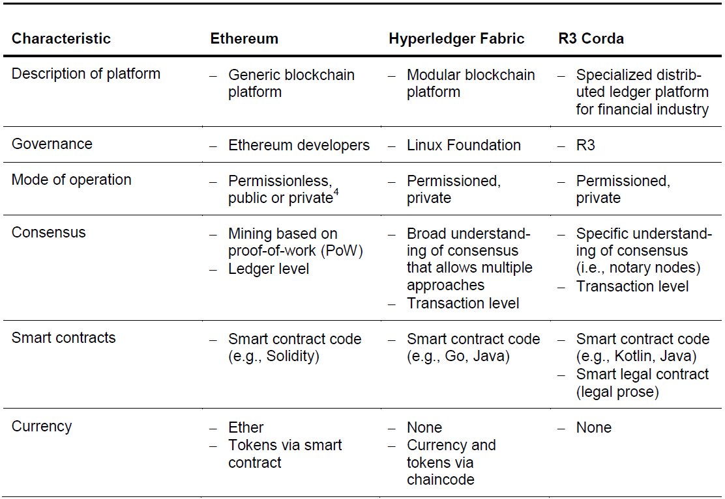
Notes:
https://medium.com/@philippsandner/comparison-of-ethereum-hyperledger-fabric-and-corda-21c1bb9442f6

Slide 38
Different platforms- Bitcoins
Public blockchain, permission-less, where anyone can join.
The underlying technology components are cryptographic hash function, digital signature, private-and-public key encryption, peer-to-peer (P2P) network, and proof of work (POW) consensus algorithm.
A decentralized network, every node has a copy of the blockcahin (complete or partial), without having to explicitly trust a third-party
non-reversible transactions each with a unique transaction ID, input Bitcoin address, the number of Bitcoins to be transferred, and the output Bitcoin address of the recipient.
The transaction initiator pays transaction fees to the miner, who tries to include the transaction in the next block. A block is processed in every 10 minutes, then recorded in the blockchain.

Slide 39
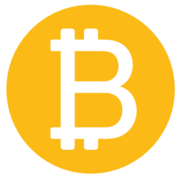
Different platforms- Bitcoins
It is not possible for anyone to capture majority of the computing power on the network, thus making the network very secure.
POW mining ensures high security of blockchain, it’s also computing-power-intensive, and requires high amount of energy.
the consensus mechanism requiring majority approval which could cause scalability issues if every node had to load entire information on blockchain and participate in the transaction validation process.
Digital signature accounts for 65% of the space in a given transaction.
‘Segregated Witness’ (SegWit) technology, bypasses the limitation on block size, and separates signature information from the transaction data, to improve scalability of the network.
Notes:
https://www.investopedia.com/terms/s/segwit-segregated-witness.asp

Slide 40
Ethereum
It’s a public, permission-less blockchain
It uses similar technological backbones, for e.g. cryptographic hash function, private-and-public key encryption, P2P network, etc
Proof-of-Work consensus algorithm
Its native cryptocurrency, is called Ether.
Ethereum provides a blockchain platform,
Developers can launch their own blockchain projects (DApps), including cryptocurrencies (VeChain and OmiseGo).
Ethereum Virtual Machine (EVM),
Notes:
Ether has the second highest market cap, behind only Bitcoin.

Slide 41

Ethereum
Smart contracts are pieces of code, which allows execution of legal functions
taking control of an entity based on certain conditions, and transferring crypto tokens based on fulfilling required conditions.
Smart contracts on the Ethereum platform are codes using a proprietary language Solidity.
Deployment and each execution of a smart contract written to the blockchain will cost you Gas, which in turn exchanged into Ether.
DApps are applications runs on a decentralized blockchain, using smart contracts.
The frontend code can be written in any language.
Notes:
Ethereum’s proprietary language Solidity, which is inspired by C++, Java, Python and JavaScript.

Slide 42

Ethereum
DApps can be built for Ethereum that allow monetary transactions.
DApp, must meet the following conditions:
Fully open-source
It must operate autonomously
The app must use a crypto token, and no one entity can control majority of the crypto tokens
A consensus of the users determines future changes to the app
Data must be cryptographically stored in a decentralized blockchain
A standard cryptographic algorithm must be used to generate the crypto tokens (i.e. PoW).

Slide 43
Ethereum
Ethereum also provides a way for the user to specify how much computing power will be expended for a transaction, by using a measure of processing power, called Gas
Can specify a gas limit.
If a transaction remains within that limit then it’s executed,
If it exceeds the limit, then the changes are reverted. S
Simple payment transactions require less gas, whereas deployment of smart contracts, require more gas.

Slide 44
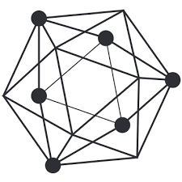
Hyperledger Fabric
Hyperledger consortium was formed by the Linux foundation, and many other partners such as IBM, Intel, SAP, Cisco, Daimler, and American Express, to design and develop enterprise blockchains.
A permissioned blockchain, only the entities explicitly trusted by the organization(s) can join it.
While this enterprise blockchain can be used in any industry, not suitable for cryptocurrencies.
Hyperledger has a multimodular architecture and any domain can be implemented
it also has a framework for developing blockchains called Composer.
Also connect to legacy IT infrastructure
Notes:
Business does not like public open networks where everyone can read the transactions
Even among the trusted participants in a network they like access to be role based.
Business what blockchains that are highly scalability and fast transaction speed

Slide 45
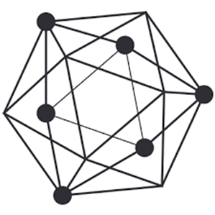
Hyperledger Fabric
Hyperledger Fabric supports private transactions by creating multiple ledgers called channels.
By default, a network will run without any consensus algorithm, can plug in Practical Byzantine Fault Tolerance or even a custom-made one.
Smart contracts (called Chaincode) are written using Golang or Node.js.
Chaincode is running in the Docker container
so i isolated from any other processes.
If you want the chaincode on two channels, then you must deploy it twice.
In some cases, Hyperledger might be the best blockchain platform for in company business use.

Slide 46
Hyperledger Fabric
Consensus mechanism looks at the entire transaction flow, and nodes have different roles, with different tasks.
Differentiated nodes based on whether they are clients, peers or orderers.
A client creates and invokes transactions.
Peers maintain the ledger, receive ordered updates from orderers, upon which they commit the transaction into the ledger.
Special Peer type- Endorsers, check whether the transactions meet necessary and sufficient conditions (for e.g. required signatures) and endorse them.
Orderers provide a communication channel to clients and peers over which messages containing transactions can be broadcasted.
the channels ensure that all connected peers are delivered exactly the same messages with exactly the same logical order.

Slide 47
Hyperledger Fabric
Consensus algorithm is “pluggable”,
application-specific requirements various algorithms can be used.
For example, in order to deal with random or malicious replication faults as a variant of the Byzantine fault-tolerant (BFT) algorithms could be used.
Channels partition message flows,
so that clients only see the messages and associated transactions of the channels they are connected to and are unaware of other channels.
This way, access to transactions is restricted to involved parties only with the consequence that consensus has only to be reached at transaction level and not at ledger level as with Ethereum.
Fabric allows fine-grained control over consensus and restricted access to transactions which results in improved performance scalability and privacy.
Notes:
A client sends a transaction to connected endorsers in order to initiate an update of the ledger.
All endorsers have to agree upon the proposed transaction, thus some sort of consensus has to be reached regarding the proposed ledger update.
The client now successively collects approval of all endorsers.
The approved transaction is now sent to connected orderers which again reach consensus.
Subsequently, the transaction is forwarded to peers holding the ledger for committing the transaction.

Slide 48
Hyperledger
The overarching Hyperledger design philosophy is a permission block chain made of modules hat enables extensibility and flexibility.
The reference architecture of hyperledger identifies several key layers of components (not packed in the same protocol)
Consensus.
Smart contracts.
Communication protocol.
Data storage cryptography.
Id management governance API eyes and interconnectivity.

Slide 49
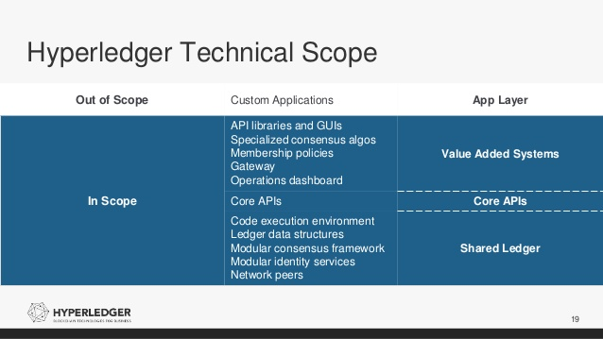

Slide 50
Finaincial Example.
The important shared facts between financial institutions are financial agreements
such as bank A and bank B agree that bank A owes one million U.S. dollars to bank B payable on demand. This is a cash demand deposit bank
bank B agreed that they are parties to a credit default swap with the following characteristics. This is a derivative contract .
bank A and bank B agree that bank is obligated to deliver 1000 units of common stock to bank B in three days time in exchange for a cash payment of 150000 U.S. dollars. This is a delivery versus payment agreement.
The financial industry is pretty much defined by the agreements that exist between its firms and these firms share a common problem.

Slide 51
Financial Example
These systems typically communicate by exchanging messages
I sent an update to you about the new sale of the agreement.
Financial institutions spend a lot of money on reconciling their books to check if all parties are on the same page. And if not they have to spend even more money to fix any inconsistencies or other issues uncovered.
So what is needed is a system for recording and managing financial agreements that is shared across firms that recorded the agreement consistently and identically.
That was visible to the appropriate regulators and which was built on industry standard tools with a focus on interoperability and incremental deployment and which didn't leak confidential information to third parties.

Slide 52

R3’s Corda
Designed specifically for financial services sector, and to operate under stringent regulatory requirements prevalent in this industry
Started in 2015 with 9 banks, 2018 over 200 banks
save banks money by making their operations faster more efficient and transparent.
Each network has a doorman service that has a set of KYC rules to join.
If a peer is accepted, a certificate is granted that will help identification inside the network.
By default, information about transactions is only shared with those who participate in the transaction (not the rest of the network).
each peer only sees a subset of facts on the ledger, and no peer is aware of all the facts in a ledger
Notes:
KYC know your customer

Slide 53
R3’s Corda
Uses a java virtual machine
Consensus mechanism requires transaction validity and uniqueness.
Notaries Nodes are centralized nodes or distributed using a pluggable consensus algorithm like RAFT or BFT (or similar)
Notaries can also validate a transaction.
Oracle services provide the data from the outside world to the ledger.
Smart contracts contain specific legal expressions, in addition to the code, to give it legitimacy
Smart contracts ensure validity, and if there is no other transaction that consumes any of the input states for this transaction in question, then it’s unique

Slide 54
R3’s Corda
Smart contracts in Corda consist of three elements:
State objects – stores the data that are checked by the contract. Represent state of a ledger. Exist in output and input.
Commands – additional data for transaction they are parametrizing the contract. Passed as input to contract.
Verify function – validation function as it validates the transaction. If the transaction is returned then it’s successful if exception occurs we have failure
Contracts are packaged to CorrDapp (Corda distributed application) with other objects.
Other objects that CorDapp can consists are Services (Oracles and Notaries) and Flows.
Flows are contained in the so called FlowLogic class and are used for handling business flow scenarios.

Slide 55
R3’s Corda
Subject to consensus is transaction validity and transaction uniqueness.
Validity is ensured by running the smart contract associated with a transaction, by checking for all required signatures and by assuring that any transactions that are referred to are also valid.
Uniqueness concerns the input states of a transaction. Specifically, it has to be ensured that the transaction in question is the unique consumer of all its input states. In other words, there exists no other transaction that consumes any of the same states. The reason for this is to avoid double-spends.
Immutability in enforces by the systems, other network participants will not accept a block chain with past transaction history different than the one they have store.

Slide 56

Ripple
While Ripple protocol uses many of the features we know, such as decentralized design, cryptographic hash functions, P2P network, and private-and-public key encryption.
has unique features specifically designed to facilitate fast and cheap global transfer of money.
Ripple’s native cryptocurrency XRP
‘Ripple Protocol Consensus Algorithm’ (RPCA), which uses a ‘proof of correctness’ concept.
All nodes apply RPCA every few seconds;
Upon reaching consensus, a ledger is considered ‘closed’, and then it’s the last-closed ledger;
All nodes will have identical last-closed ledger
RPCA happens in rounds

Slide 57

Rippple
RPCA happens in rounds, and in each round:
a ‘candidate set’ of all valid but unapplied transactions is put into public list
Each server has a unique node list (UNL), of other servers queried by this server
Each server takes all candidate sets of all servers in its UNL, and makes a combined list, before voting on that list;
Transactions that receive more than the threshold of ‘yes’ votes are taken to the next round, and the others are either discarded or moved to the candidate list for the next round;
The final round requires 80% of the servers on a servers UNL to agree on the transaction, before being applied to the ledger
After applying all the approved transactions in the ledger, the ledger is closed, and becomes the new last-closed ledger

Slide 58
Ripple’s XRP
While similar to bitcoin, XRP much faster than bitcoin and can scale to provide a similar number of transactions per second to that of Visa.
Each lasts about 4 seconds per transaction and is deterministic.
Each transaction in XRP is validated by validators
everybody can become a validator.
It’s also saved in the blockchain ledger.
Ripple has a decentralized exchange and arbitrary assets.
Ripple has been criticized for not being truly decentralized, and for using only a few core validation nodes.

Slide 59
Ripple
Ripple’s aim is that XRP will become a “bridge currency”
use to settle cross-border payments faster and more cheaply than using current global payment networks with its fees and slower process.
Bitcoin can also do cross-border payments, but it can only settle 7 transactions per second.
Ethereum can settle around 150 smart contracts per second.
Ripple, on the other hand, claims it can settle 1,500 transactions per second: 24 hours a day, seven days a week, 52 weeks a year.
Ripple is recognized as a legal tender by several governments, which gives it instant liquidity via financial institution, as well as purchasing power over material goods.

Slide 60
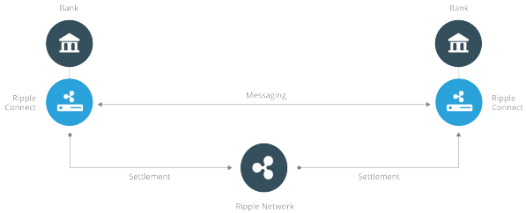
Ripple
In Jan, 2018, Ripple partnered with MoneyGram who are now using XRP to speed up and reduce the cost of transferring money.
Notes:
MoneyGram (a cross-border money transfer company)

Slide 61
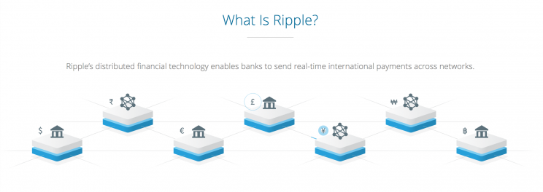
Ripple
The status quo when you send money (in one currency) to another currency using a banks, this conversion takes several business days and involves multiple stakeholders who get paid a fee.
Ripple acts as a central currency, XRP.
So now if you were to send USD to your friend in India (INR), the US bank would trade USD for XRP and then trade XRP for INR.

Slide 62
 | Ethereum | R3 Corda | Hyperledger Fabric | Ripple
Private / public network | public | private | private | public
Consensus protocol | PoS could also be PoW | Pluggable (RAFT or BFT or custom) | Pluggable (No-op or Practical Byzantine Fault Tolerance or custom) | Ripple Protocol Consensus (variation of FBA)
Smart contracts supported | yes | yes | yes | no
Smart contracts language | solidity | java/kotlin | Golang or node.js | –
Cryptocurrency | Ether | – | (can be modeled in chaincode) | XRP
Transaction cost | Yes (high) | No | no | Yes (low)
Notes:
https://espeoblockchain.com/blog/best-blockchain-platform/

Slide 63
Issues
scalability matters - how many transactions can the network handle at a given time, can it grow
Scalability of blockchain largely depends on the consensus mechanism.
Ethereum, R3 Corda, Quorum, Hyperledger Fabric each have a mechanism for implementing Turing-complete Smart contracts.
Corda contracts are set of stateless functions and only verify the transactions.
Ripple has no notion of smart contracts.
Note
Visa handles about 2000 transactions per second.
Amazon has around 600 transactions per second in its peek, bitcoin handles 7 transactions per second, Ethereum handles around 20 transactions per second.
Notes:
Visa handles about 2000 transactions per second.
Amazon has around 600 transactions per second in its peek, bitcoin handles 7 transactions per second, Ethereum handles around 20 transactions per second.

Slide 64
issues
Private or public
Public Blockchains (permissionless ) have proven security mechanisms, but all transaction can be seen by everyone.
Private Blockchains ( permissioned), confident that sensitive information is realised to selected partners.
Do not have the advantage of a thousand eyes looking at the code as with open source code.
Tend to be faster as the consensus algorithm works in a friendly environment with a limited number of users.

Slide 65
issues
Ethereum – Ether is used to pay rewards to nodes that contribute to reach consensus by mining blocks as well as to pay transaction fees.
Can create a custom currencies or assets
A digital token can be created by deploying a smart contract
Fabric and Corda do not require a build-in cryptocurrency as consensus is not reached via mining.
Fabric can develop a native currency or a digital token with chaincode.

Slide 66
Summary
We looked at how the concept of bitcoin could be taken further to other forms of economies.
The we examined how the different types of consensus algorithms are used on the blockchain with cryptocurrencies.
The we had a brief description on the common platforms available

